Slide 1


PEL132-
COMMUNICATION SKILLS II
LECTURE 0

Slide 2
Objectives
To enhance the listening, speaking, reading and writing skills of the students
To assess the accurate usage of grammar rules in conversation

Slide 3

Course Details
LTP 1-0-3

Slide 4

Course Outcomes
Course Outcomes :Through this course students should be able to
CO1: understand vocabulary, intonation and style of connected discourse as the basis for developing language skill
CO2: demonstrate the unique qualities of professional writing style
CO3: employ correct linguistic structures when expressing ideas
CO4: appraise the written & spoken text to understand the various components of comprehension
CO5: develop adequate skills to communicate effectively
CO6: produce different pieces of communication using appropriate grammar.

Slide 5


Program Outcomes as specific to the particular course :PO10
Aiming to improve
Written & oral communication
Vocabulary to choose language that precisely expresses meanings
Articulation of the thoughts in correct sentence structure

Slide 6

Course content
Language Skills
Listening: listening to people in different roles and situations, listen to answer, fill ups, understanding context, matching statements, true/false, paraphrasing the text, making comparisons, making inferences, understanding details, understanding theme, recreating dialogues, understanding the analysis & reviews
Speaking/Pronunciation: giving self-introduction, giving description, discussions in small groups,presenting information, giving opinions, making a short talk, interviewing a partner, working in groups and enacting roles, discussing possible scenarios, describing change, comparing different times and their consequences, describing abilities and skills, taking stance, showing agreement and disagreements, syllable stress, stress and rhythm

Slide 7
Course content
Language Skills
Reading: understanding meaning in context, understanding themes, matching questions and answers, inferring information, finding comparisons, writing crux, making notes and recreating text
Writing: paragraph writing, cover letter, report, review, writing articles, making notes, making lists, blogs, messaging, story writing, making profile, explanation of points, précis

Slide 8
Course content
Course content
ASSOCIATED LANGUAGE SKILLS
Grammar: past tense, evaluation and comparisons with adjectives, future tense and modal verbs, twopart verbs, infinitives and gerunds for uses and purpose, relative clauses of time, time contrasts, conditional sentences, gerunds, short responses, past continuous vs. simple past, participles as adjectives, unreal conditional sentences with if clauses, reported speech Vocabulary: vocabulary for sharing memories, lifestyle vocabulary, travel vocabulary, phrases, technology vocabulary, holidays and festival vocabulary, collocation, words describing personality (adjectives), words describing actions(adverbs), synonyms, antonyms, verb-noun collocations
Practical: listening to people talk about their life experiences, listening to people give suggestions on different topics, listening to a radio program, listening to description of different events, listening to reviews and opinions, speaking about one’s traits and qualities, speaking to share experiences, speaking to describe personal and professional subjects, speaking to share reviews and opinions, reporting what people said, reading about people and their achievements, reading about unusual events and experiences, reading about places and cultures, reading formal and informal communications, writing paragraphs and business letters, writing descriptions, writing blogs and reports

Slide 9
Cohorts
Cohorts | Communication Skills(LSRW)
Data Analyst, Machine Learning Engineer, Data Scientists,CyberSecurity Manager/Analyst/ Architect, Software Testing Assistant/Content Writer/Freelancer,QAEngineer, Frontend/BackendEngineer.Fullstack Engineer, MLEngineer, DevOps Engineer, Production and Manufacturing Engineer,GraphicDesigner, Process Analyst | Teaching these skills equips students with the tools they need to succeed academically, professionally, and socially. It empowers them to express themselves effectively, build strong relationships, and navigate the complexities of the world around them.

Slide 10
Execution Strategies
The course design and curriculum has been aligned with the overall objectives of the program, ensuring a coherent and progressive development of listening, speaking, reading, and writing skills.
Active learning strategies are employed to encourage student participation and engagement, involving interactive activities, role-plays, debates, group discussions, and language games.
Integration of modern technology, such as multimedia and language learning labs, will further enhance language acquisition.
Formative assessments will be used to monitor students' progress and provide timely feedback, while summative assessments to evaluate their overall language proficiency.
A multilingual approach will be adopted, acknowledging and celebrating the linguistic diversity of students.
The course will integrate cultural elements and local context to make learning more meaningful and relevant.
Inclusivity and accessibility is ensured, catering to the diverse needs and abilities of all students.

Slide 11
Execution Strategies- Course Importance
This course is LSRW course. Engaging in LSRW (Listening, Speaking, Reading, Writing) activities in the classroom leads to comprehensive language development. Students enhance their listening skills through exposure to various accents and contexts. They become confident speakers, articulate writers, and proficient readers, broadening their understanding of language nuances and cultural perspectives. LSRW cultivates effective communication and fosters critical thinking.

Slide 12
MOOCs/Industry Certification/National/International competition or Tests:
Test/Examination | IELTS (International English Language Testing System) | 8 Bands | All AT exempt

Slide 13

The Exam Mode
CA
MTP(Mid term practical)
ETP(End term practical)

Slide 14

Course Assessment Model
Marks break up*
Class participation 15
CA (4 out of 4 tasks) 30
MTP 15
ETP 40
Total 100

Slide 15
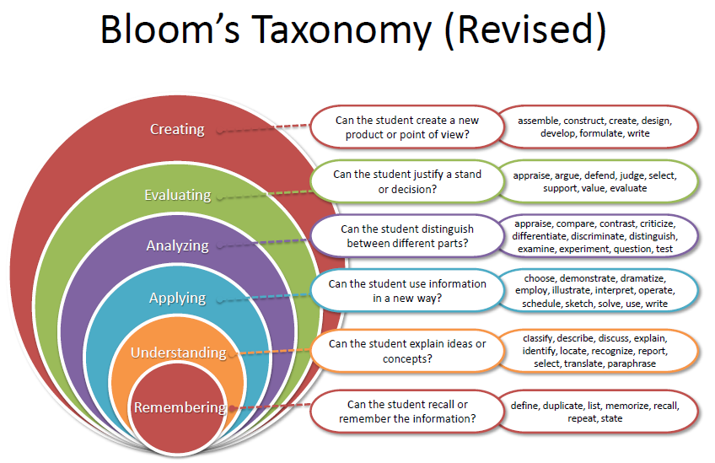

Revised blooms taxanomy

Slide 16
CA Pattern
Details of Academic Task(s)
Details of Academic Task(s)
Academic Task | Objective | Detail of Academic Task | Nature of Academic Task (group/individuals) | Academic Task Mode | Marks | Allotment/su bmission Week
Test 1 | To assess students’ ability of listening & writing effectively | fill in the blanks based on listening track, paragraph writing on childhood memories and informal email writing | Individual | Offline | 30 | 3/4
Presentation- individual 1 | To assess students’ ability to speak at various situations | self introduction and describing vacation plans | Individual | Offline | 30 | 5/6
Test 2 | To assess students ability in listening, reading and writing | filling in the blanks, comprehension passage, describing technology and writing messages | Individual | Offline | 30 | 9/10
Test 3 | To assess students’ reading & speaking skills | Describing abilities and skills, past events | Individual | Offline | 30 | 11/12

Slide 17
Books
Type | Name | Author | Publisher Name
Text book | INTERCHANGE LEVEL 2 | INTERJACK C. RICHARDS, with JONATHAN HULL, with SUSAN PROCTOR | CAMBRIDGE UNIVERSITY PRESS
Reference Book | ENGLISH GRAMMAR IN USE | RAYMOND MURPHY | CAMBRIDGE UNIVERSITY PRESS

Slide 18
Relevant Websites
https://www.youtube.com/watch?v=-B7W2bV1TOE- Relative pronouns as subjects and objects
https://www.youtube.com/watch?v=nM3GmNJ3lzQ – Gerund phrases as subjects and objects
https://www.youtube.com/watch?v=Nk9nQwoCFig - Models
https://www.youtube.com/watch?v=du34F6p9rQ8- Tenses
https://www.youtube.com/watch?v=d7qOWm65nUo- Time clause

Slide 19
CPE Activities

Slide 20

Students’ Role
Always communicate in English with your friends and in other classes too
Be enthusiastic in participating in classroom activities
Actively participate in solving worksheets
‘Brevity is the soul of wit’, so try to convey your ideas in few words
Utilize accurate vocabulary while communicating for better emphasis
Ask volley of questions whenever there arise a doubt in your mind
Reading enhances speaking, so make the habit of reading newspapers and for current affairs

Slide 21
Parameters For CA1- Writing
Task Achievement/Response
Coherence
Vocabulary
Grammar
accuracy
Sentence Structure
Task Response
Spelling and Punctuation

Slide 22
Rubrics For CA2- Individual Presentation
Vocabulary range and Control
Grammatical Accuracy
tone
pronunciation
Coherence
Fluency

